Slide 1
BRITISH AIRWAYS
Web scraping to gain company insights
Name : DIVYA PARDESHI
14-02-2023

Slide 2
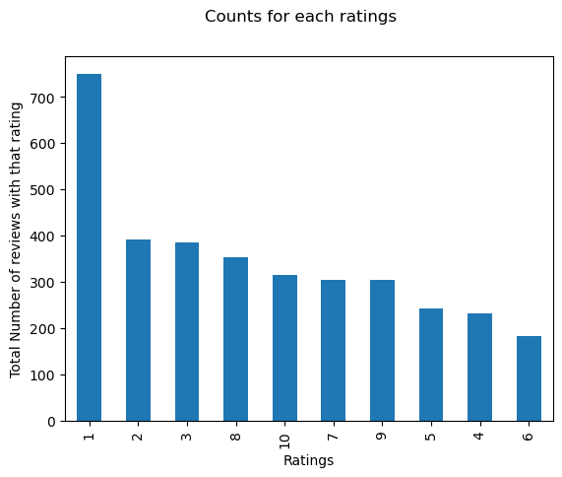
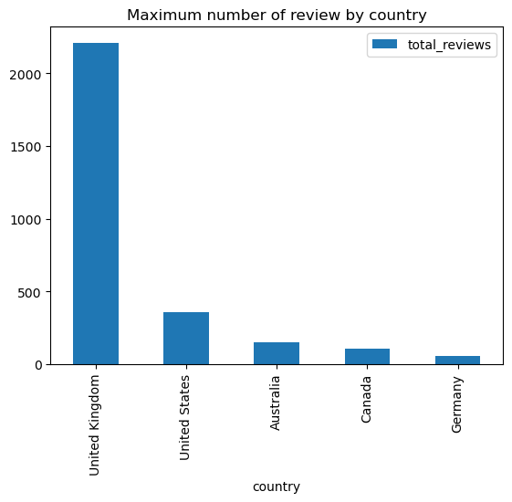

INSIGHTS FROM CUSTOMER REVIEWS:
Average Overall Rating
4.84/10
Reviews from
69 Countries
Total Collected
Reviews 3741
The people who gave 10/10 ratings were fully satisfied with the services provided by the airlines.
People who gave ratings between 1-4 wrote dissatisfaction on congested middle seat and small screen while they liked the seats and the food.
Maximum number of reviews came from United Kingdom followed by United States, Australia, Canada and Germany.

Slide 3

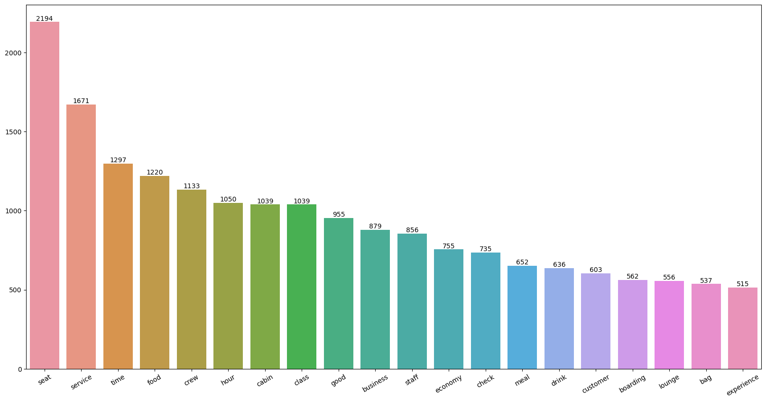
INSIGHTS FROM CUSTOMER REVIEWS:
Customers liked Cabin crew service and staff, general economy seats.
Focus on – Economy class service, seats, enhance inflight entertainment experience and importantly Delays.
Enhance the experience of business class, it seems customers want value for money.
Improve Customer service on refund requests and process.
WORDCLOUD

Slide 4
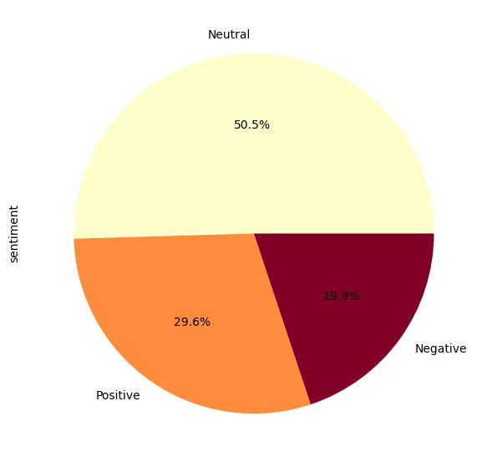
INSIGHTS FROM CUSTOMER REVIEWS:
By cleaning reviews given by the customers, we obtained
Positive Reviews – 29.6%
Negative Reviews – 19.9%
Neutral Reviews – 50.5%

